Slide 1
Counting Cards but for Equities
Group 2:
- Joseph Amo Appiah
- Etienne Brown
- Joel Williams

Slide 2
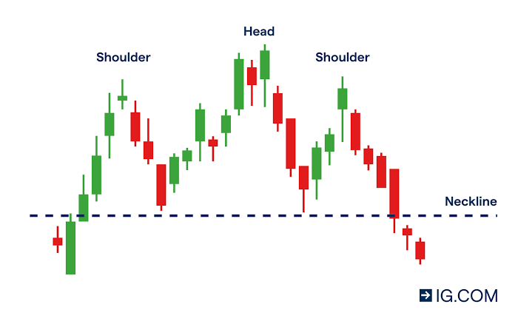
BACKGROUND AND KEY TERMS
Efficient Market Hypothesis – States that asset prices reflect all available information
Price Action – A financial analysis and speculation that generates insights based solely on price movements.
Candlestick/Bar – A chart that shows the price movement of stock during a trading day.
Bullish – A rise in share prices.
Bearish – A fall in share prices.

Slide 3

Hypothesis
Just like counting cards to simplify complex probabilistic outcomes in the game of Black Jack, we assign basic integers to bullish or bearish patterns in a stock chart.
It’s all a game of probabilities.
How can we simplify the process without sacrificing accuracy (profitability)?
We created an auto trader that tests our hypothesis using historical stock market data
The concept of counting cards can be applied to price action trading and yield profitable results.

Slide 4
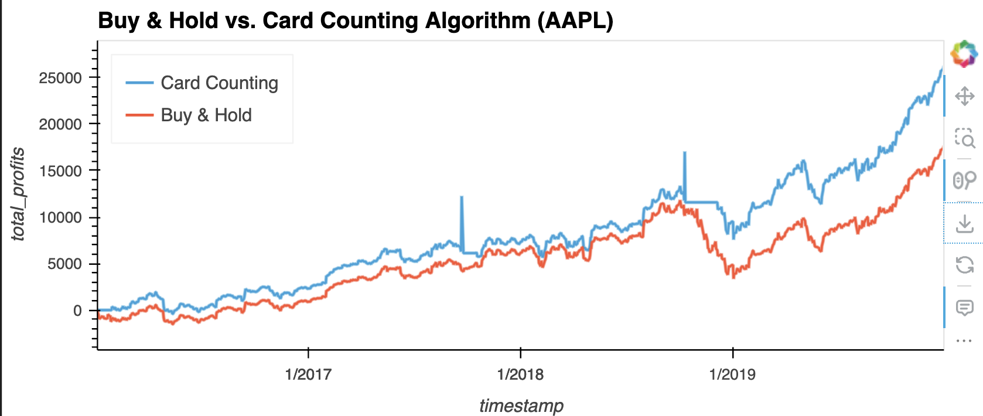
Process and Coding
1. Data processing and cleaning
2. Identify patterns to determine bullish/bearish price action tendencies
3. Identify a counting method and buy/sell thresholds
4. Execute
5. Data Analysis

Slide 5
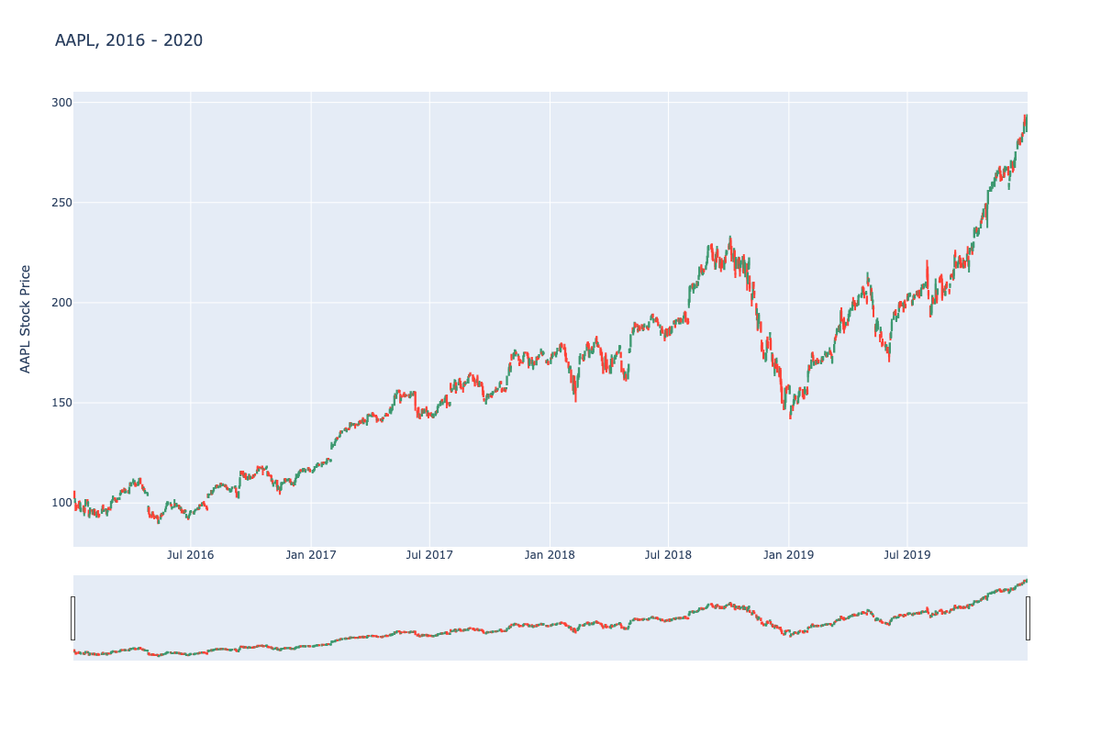
Data Display (Plotly Visualization Tool)
We first imported our stock market data and visualized this for ease of interpretation.
20XX | 20XX | 20XX | 20XX

Slide 6
CODE RUNNING

Slide 7
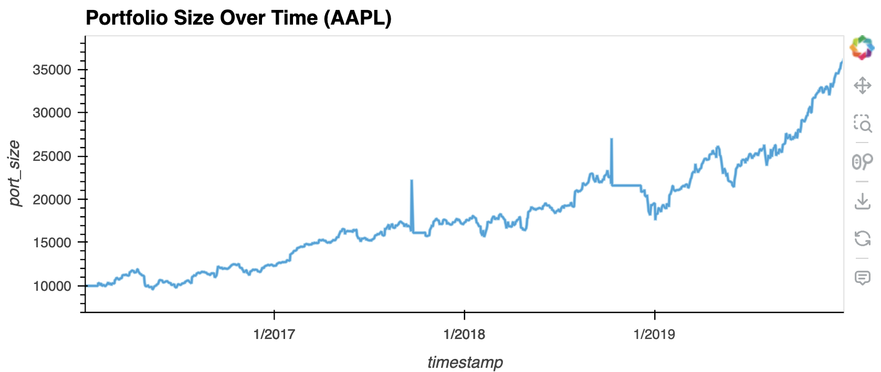
Portfolio Size Over Time

Slide 8
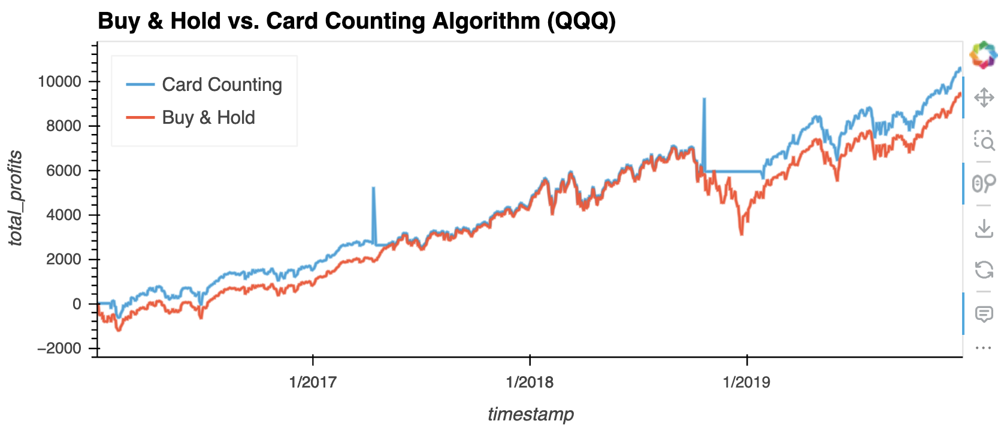
Buy & Hold Strategy vs Card Counting Algo.

Slide 9
What next?
Inspiration of this concept
Incipient steps to the process are successful
Further bearish/bullish patterns added to our code
Next step would be to run this code against a multitude number of stocks, time frames, and buy/sell thresholds

